Slide 1
Vintage Corner Cafe
“Its never too late for a coffee. After all,
Its morning somewhere in the world.”
- Zooey Deschanel
Python Project By – Bhushan Prabhakar Dhawas
My Email – bdhawas0016@gmail.com
LinkdIn – Bhushan Dhawas (link)

Slide 2
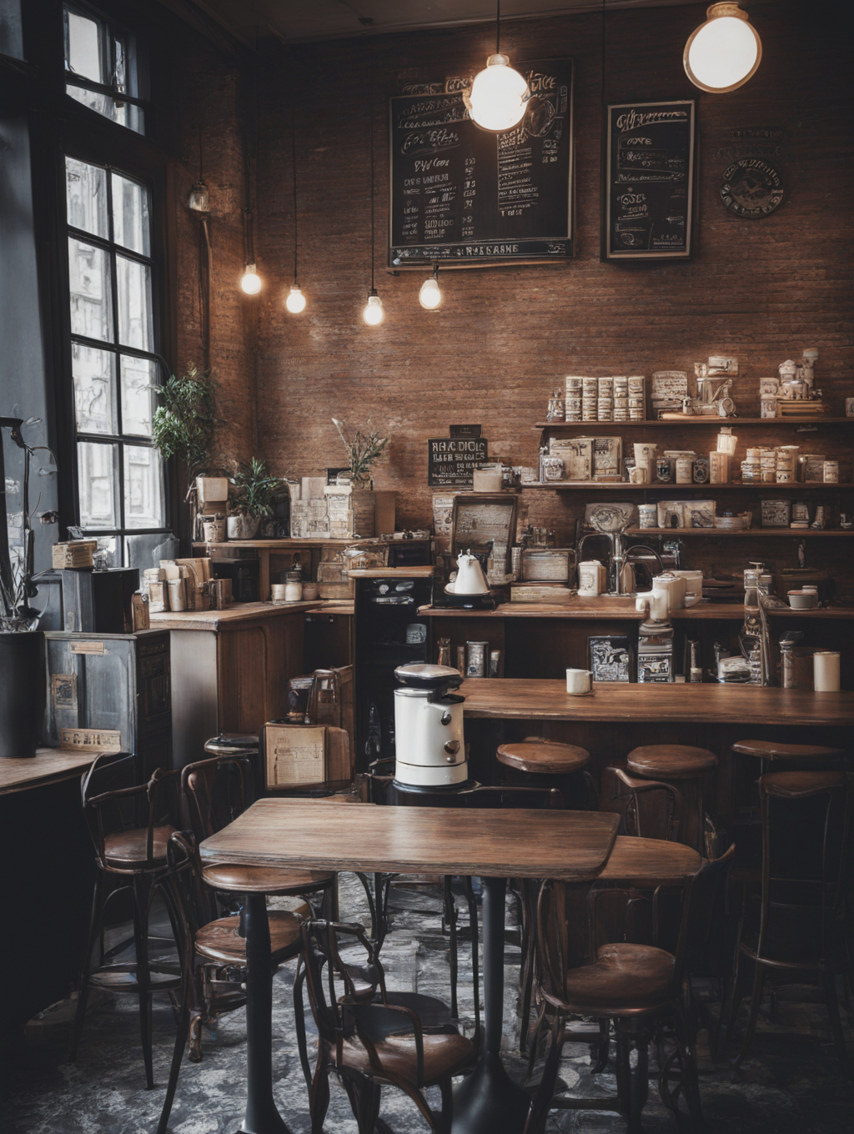
Title: "Cafe Ordering System in Python"
Objective - Using Python to create an interactive, easy-to-use ordering system. And understand how to use Python dictionaries, loops, conditionals functions in python.

Slide 3
Table of contents
01
04
02
05
03
06
Project Overview
Main Ordering Loop
Displaying The Final Order
Code Structure
Code Walkthrough
Key Concepts And Takeaway

Slide 4
Project Overview
What it Does:
Key Features:
Allows customers to order items, choose quantities, add items, and get the total price.
1.Displays a menu
2.Allows ordering with quantities
3.Repeats ordering until the user stops
4.Calculates and displays the total price
5.Finishes with a thank-you message

Slide 5
Code Structure
Main Loop:
Total Calculation and Thank-You Note:
Greeting Message:
Welcomes the user to Vintage Corner Café !
Allows repeated ordering until the user decides to stop.
Displays total amount and a friendly message at the end.
Menu Definition:
Quantity Selection:
Uses a dictionary to store items and prices.
Prompts for quantity for each item ordered.

Slide 6
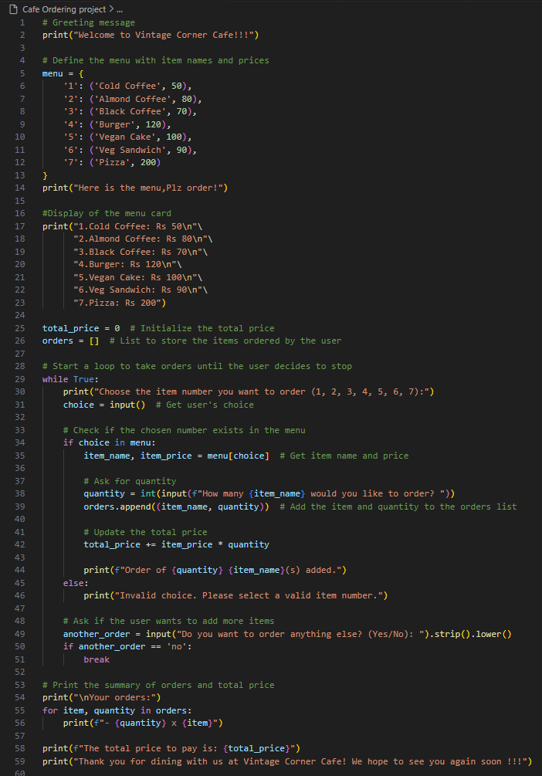
Full Python Code -
(Please check .txt file for full code of this project )

Slide 7
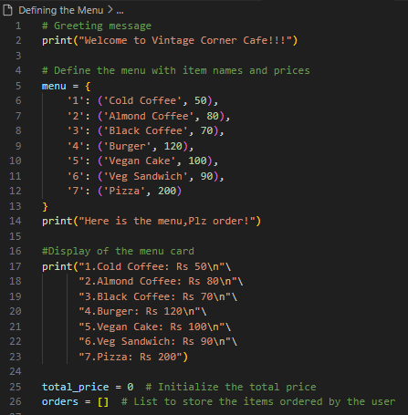
Code Walkthrough - Defining the Menu
Code Snippet:
Explanation:
1.Greeting: Welcomes the user to the cafe.
2.Menu Dictionary: Each item is associated with a number, item name, and price.
3. Display of the menu card: Menu card is displayed for the user with each item associated with a number, item name, and price.
4.Initialize Variables:
Total price for tracking the total amount.
Orders list to keep track of ordered items and quantities.

Slide 8
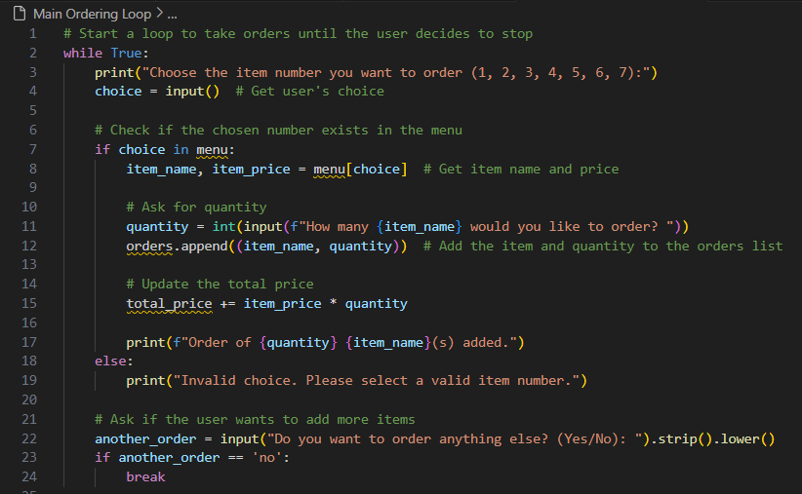
Main Ordering Loop
Code Snippet:
Explanation:
1.User Prompt: Asks for the item number.
2.Validation: Checks if the item number is valid.
3.Quantity Input: After choosing an item, the user is prompted to enter a quantity.
4.Order Addition: Item and quantity are added to orders, and the price is updated.
5.Loop Control: Continues until the user says “No”.

Slide 9
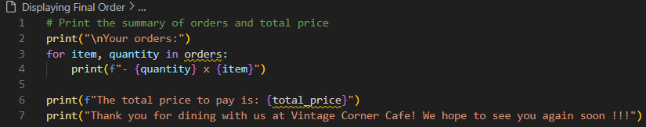
Displaying the Final Order and Thank-You Message.
Code Snippet:
Explanation:
1.Order Summary: Shows each item with its quantity.
2.Total Price: Displays the total cost of the order.
3.Thank-You Message: A friendly goodbye message for the user.

Slide 10
Key Concepts and Takeaways
1.Dictionaries:
4.Lists:
Store and retrieve menu items with their prices.
Track each ordered item and quantity for summary display.
2.Loops and Conditionals:
5.String Formatting:
Keep the ordering process going and check for valid input.
Used for creating clean, user-friendly messages.
3.User Input:
Allows the user to make choices and input quantities.

Slide 11
Potential Enhancements
Error Handling: Improve robustness by handling invalid quantity inputs.
Custom Functions: Split code into smaller functions for better readability and maintainability.
User Interface (UI): Use a GUI library like Tkinter to make a graphical version.
Additional Features: Add order history, discounts, or combo deals.

Slide 12

Thanks!
Do you have any questions?
My Email-bdhawas0016@gmail.com
LinkdIn – link (Bhushan Dhawas)
Mobile no.-8262829285
"Thank you for your attention! Happy Coding with Python."

